Slide 1
High School Book Tracking System Group 5 Viral Bhojani (A20380100) Pooja Dusane (A20380124) Purnima Yargatti (A20381813)

Slide 2
High School Book Tracking System is an web application which maintain the book repository for High School and keep track report of the books which are being checkout by either Teacher or by Student.
Technologies used are: Server side(Back-end): Java Spring Framework along with Maven Client Side(Front-end): HTML5, CSS3 and AngularJS Database: SQL Server

Slide 3
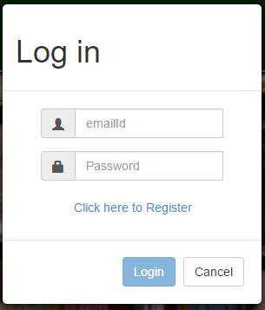
Login Page:

Slide 4
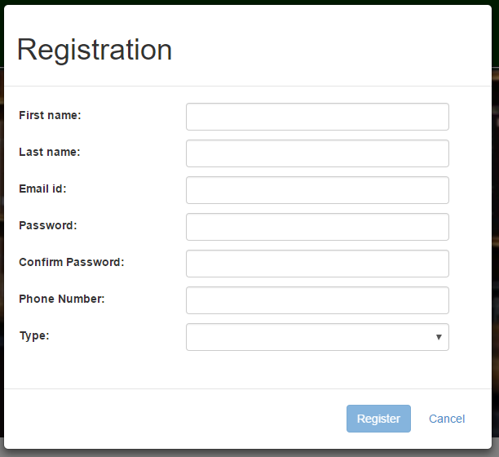
Registration Page:

Slide 5
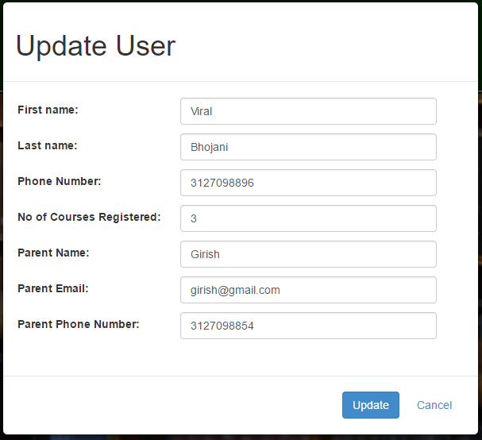
Edit User Information Page:

Slide 6
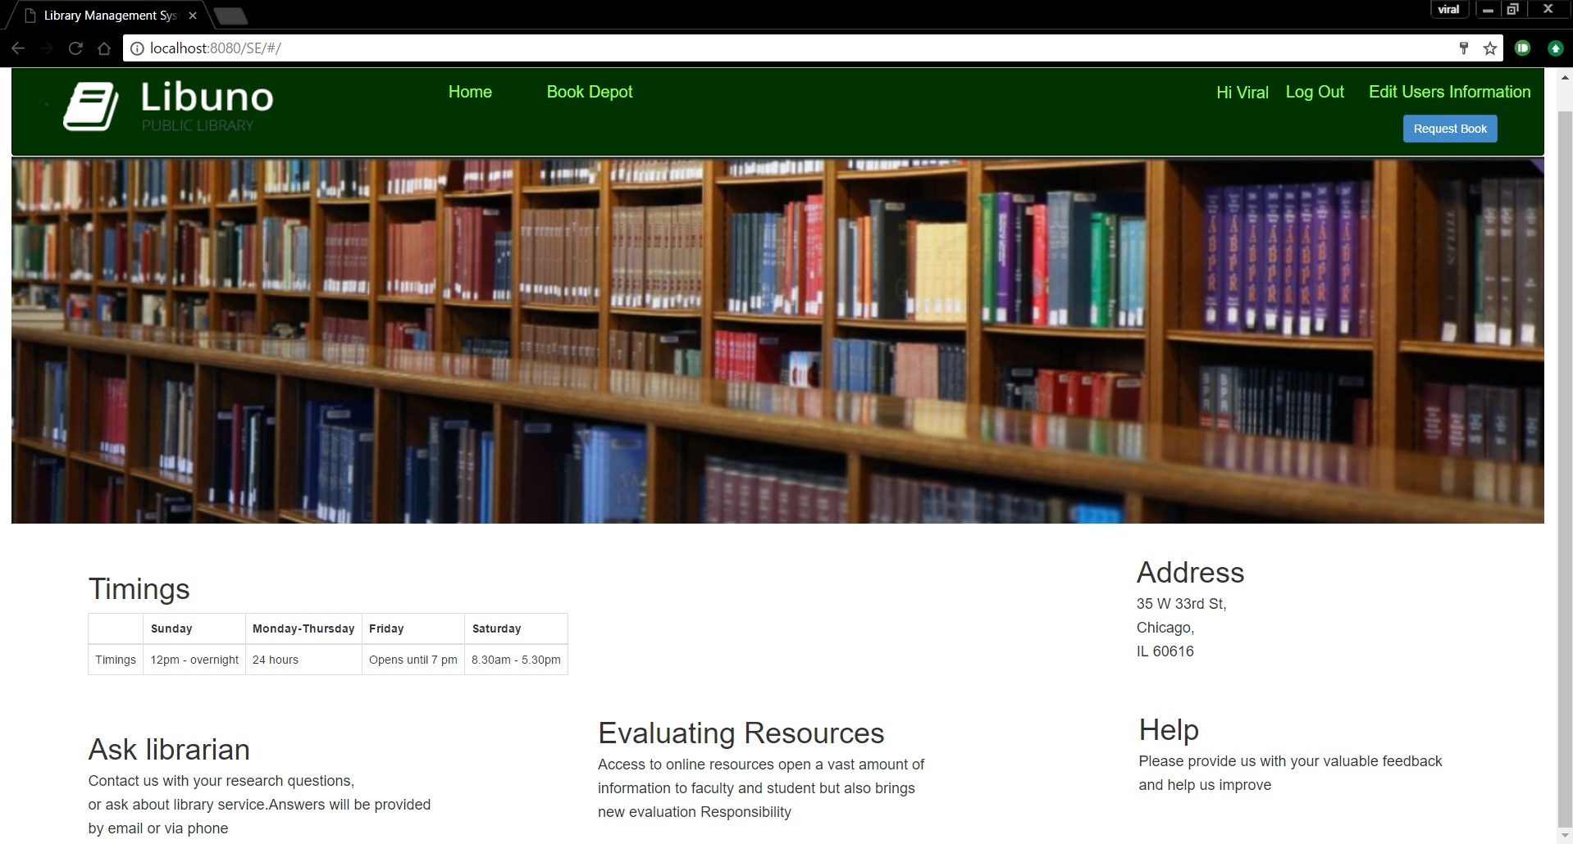
Student Home Page:

Slide 7
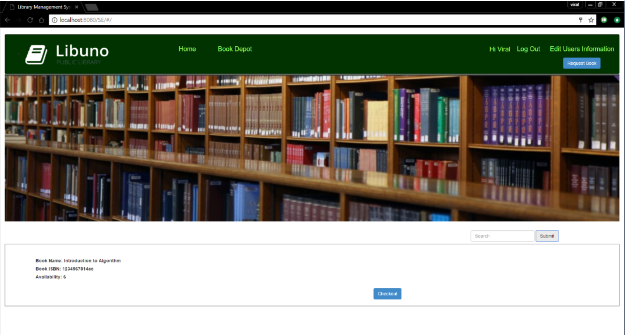
Book Depot Page
for student and
teacher:

Slide 8
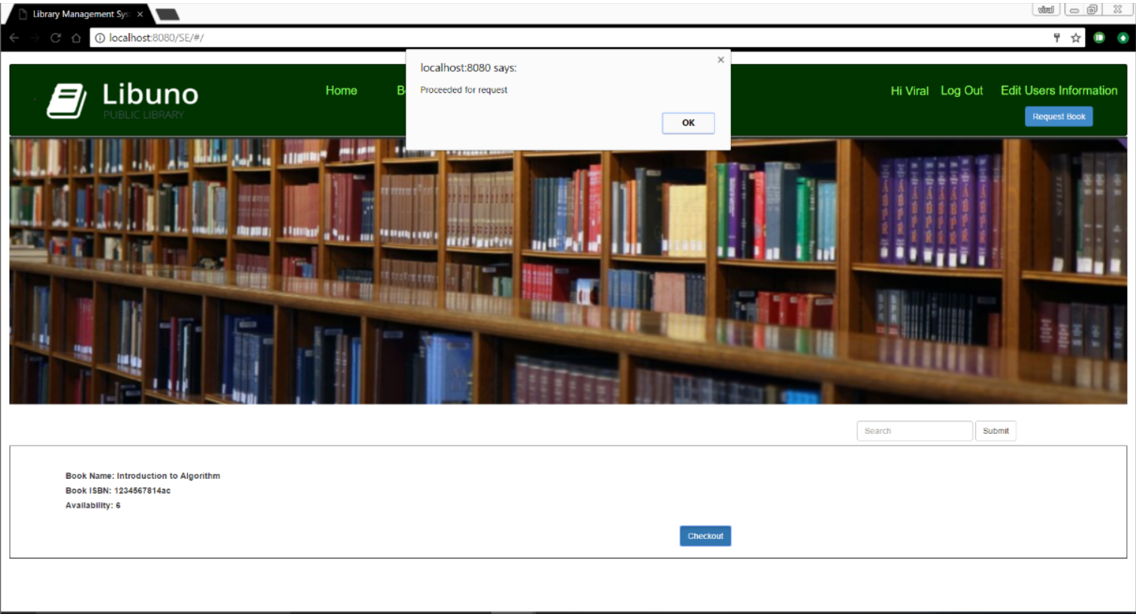
Student Checkout
Page:

Slide 9
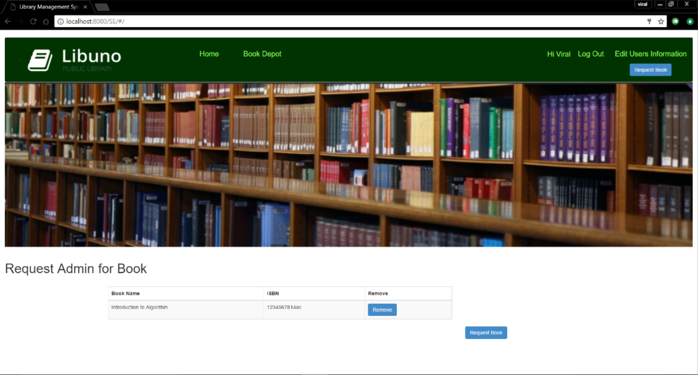
Student Request Book
Page:

Slide 10

Teacher Home Page:

Slide 11
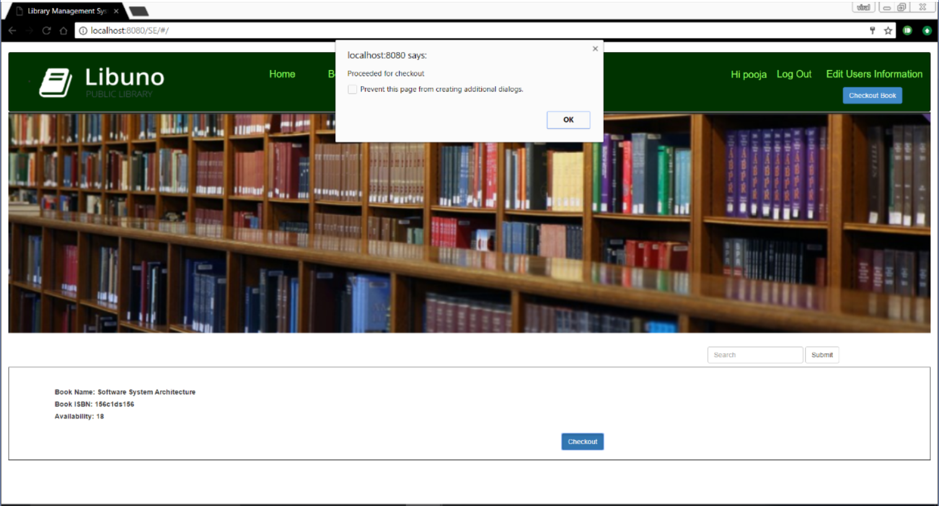
Book selected by
Teacher Page:

Slide 12
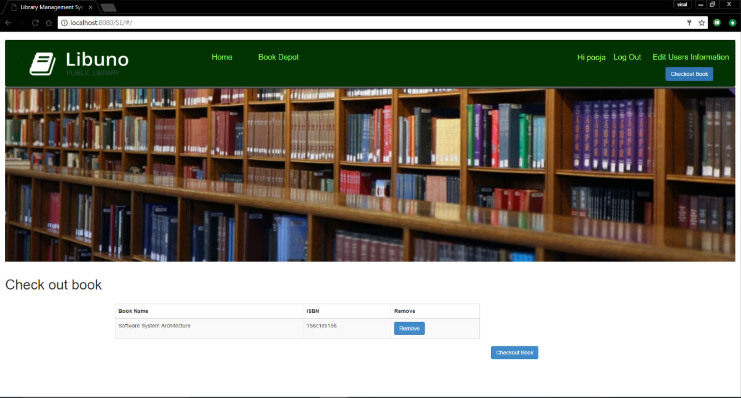
Teacher Checkout
Page:

Slide 13
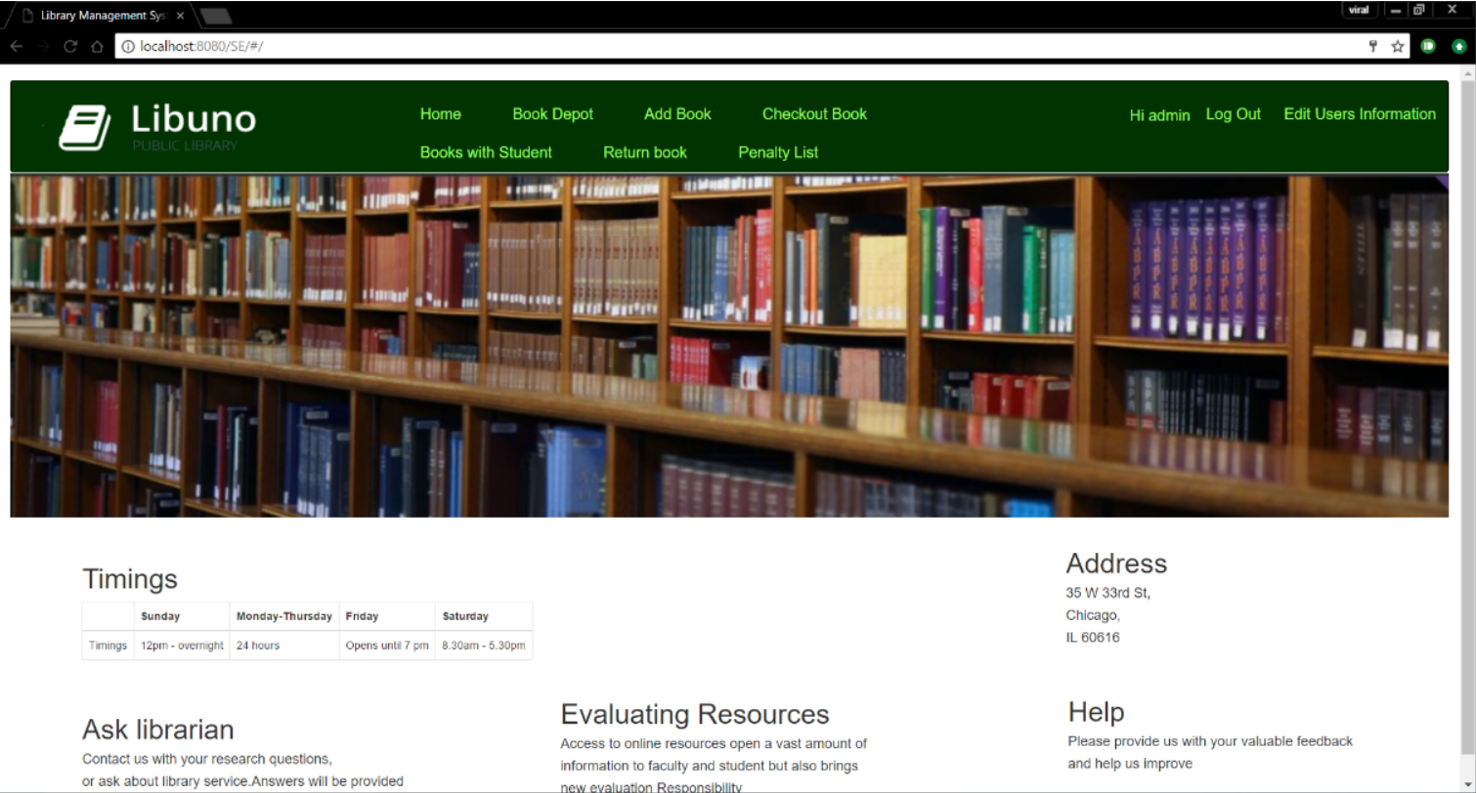
Admin Home Page:

Slide 14
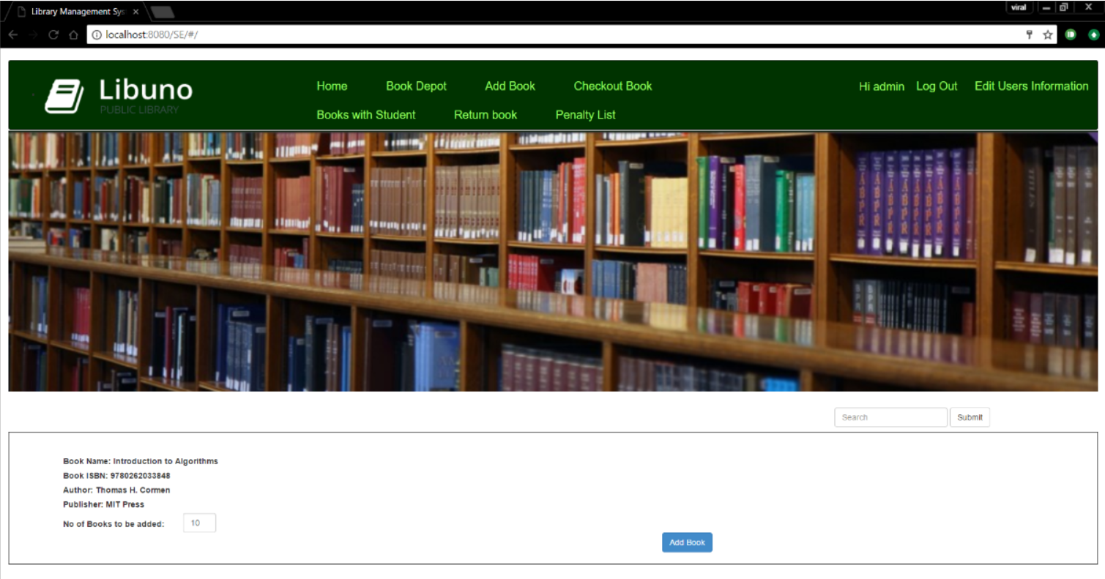
Add Book Page:

Slide 15
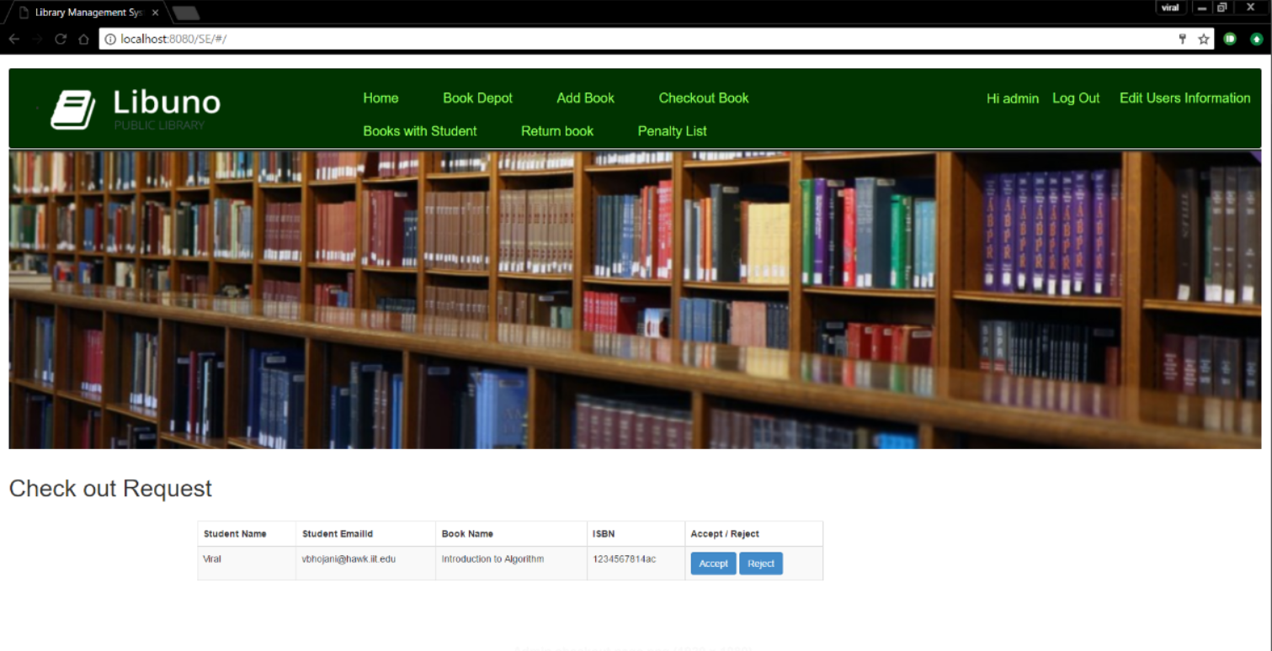
Checkout Page of
Admin to checkout
books for student:

Slide 16
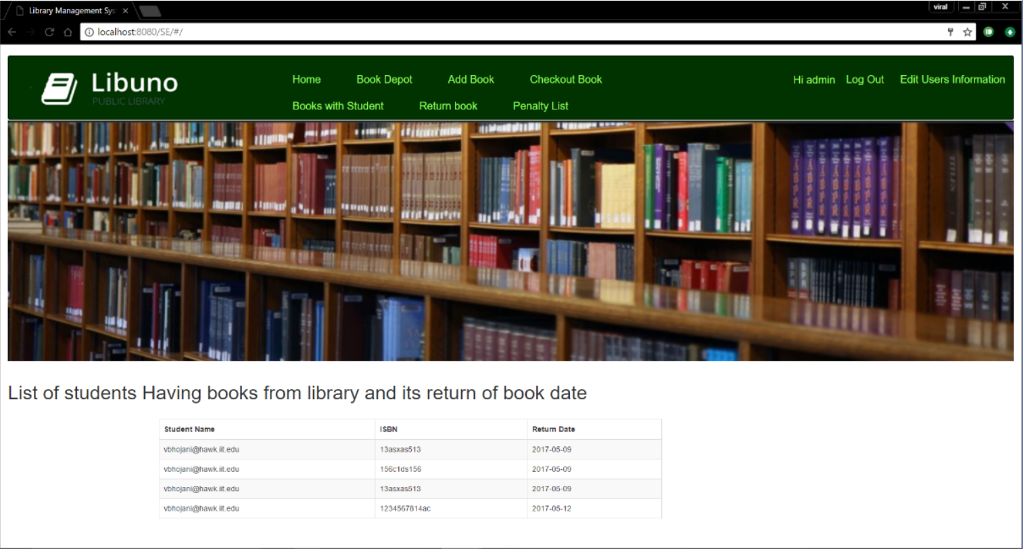
List of Students
having books page:

Slide 17
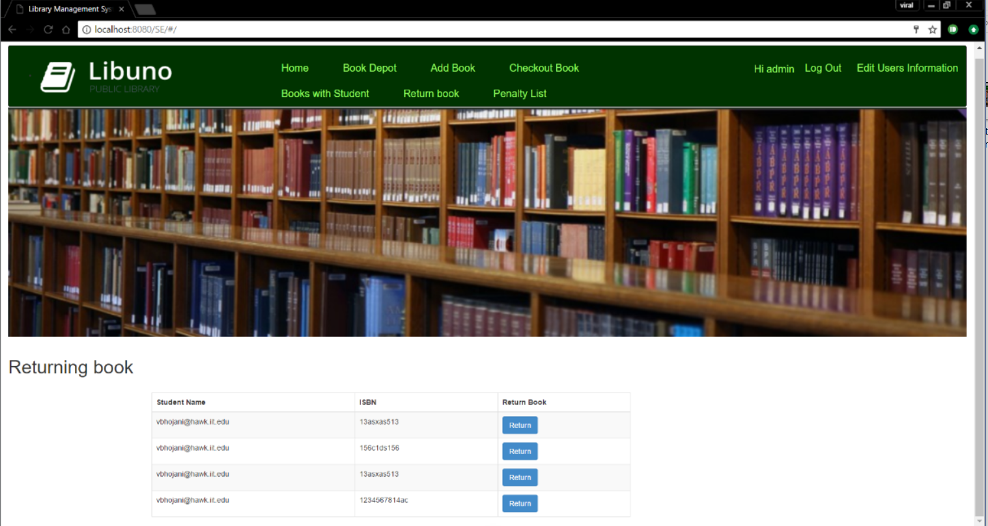
Return Book Page:

Slide 18
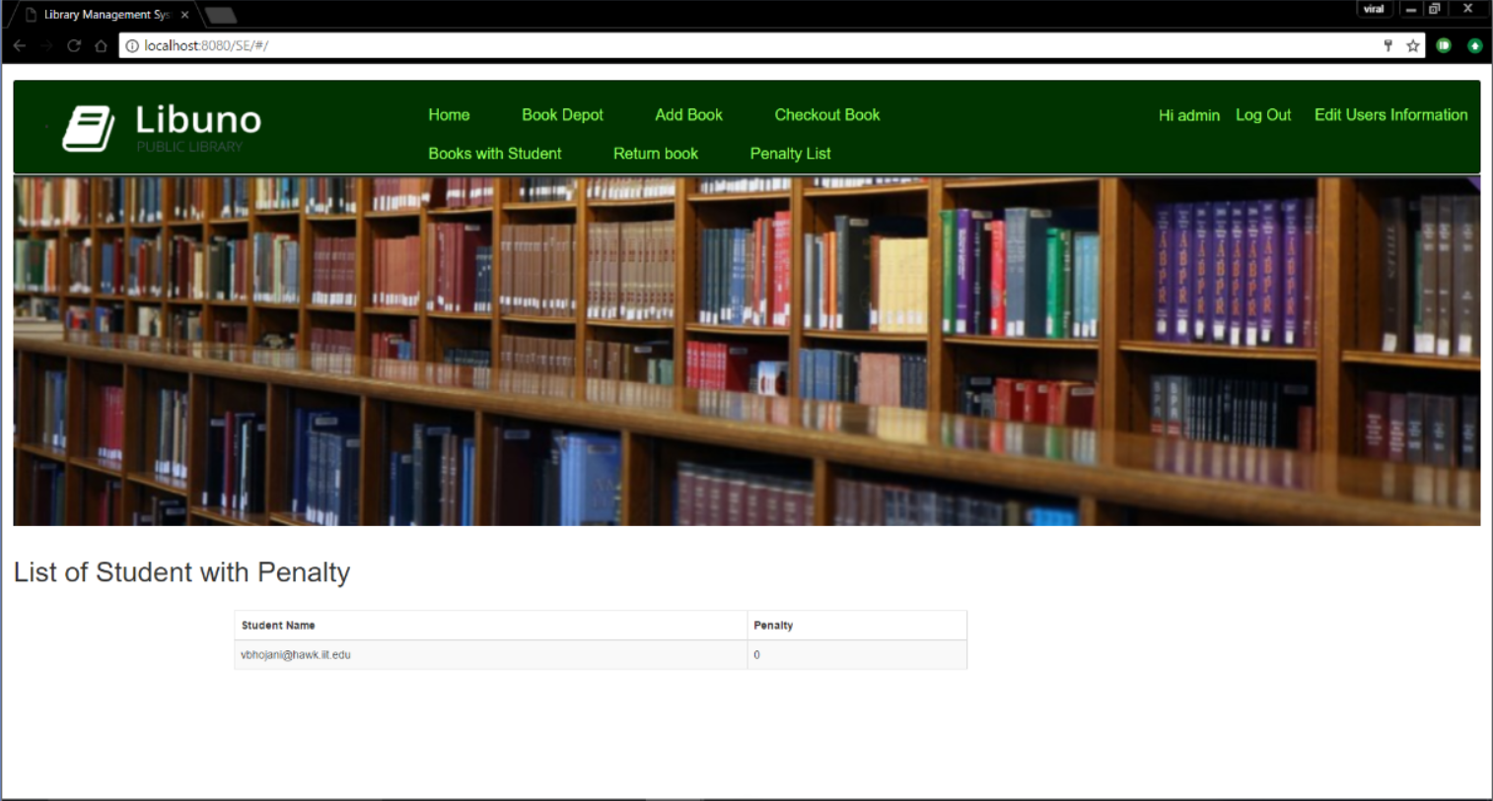
Penalty Page:

